Slide 1
Scout Unit Administration: Advancement

Slide 2
Advancement in the BSA
Advancement is important! It’s how we recognize all the work our scouts have done.

Slide 3
How do I handle Advancement?
There’s a few ways you can do advancement in the troop:
ScoutBook
Paper forms
Another troop management software

Slide 4
Scoutbook?
When it comes to advancement, Scoutbook is the simplest way to handle advancement, and in 2019, it’s free to everyone to use!

Slide 5
Make sure you’re ready
Before you can start using scoutbook for advancement, you need to make sure your registration is setup in Scoutbook. One common issue is duplicate entries.

Slide 6
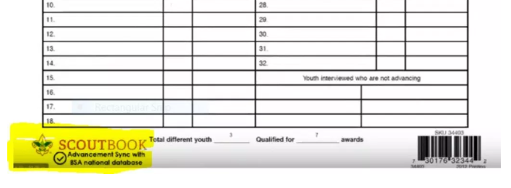
Using Scoutbook for Advancement
Mark requirements completed in the ScoutBook application
Make sure those completed items get marked approved.
Once approved and synced, the advancement report will be all you need to get the badges.

Slide 7
Paper Forms
To generate the paper forms, you’ll need to log into the internet advancement after you log into my.scouting.org
You’ll find it under Menu > Legacy Web Tools > Internet Advancement.
You’ll need to get your unit ID code by calling the scout office.

Slide 8
Paper forms
Get all of your information including merit badge blue cards, and the advancement record dates.
Click on Internet Advancement and log in with that ID you obtained earlier.
Fill in the requested information and generate your advancement report.
Get the right people to sign the report and send it to the council. Also, keep a copy, just in case!

Slide 9
Other software
Every software package is different, so check with your vendor to find out how to generate the 4403 report.
You’ll end up generating a csv file that you’ll upload in Internet Advancement from before.
Once it’s there, print your reports, get them signed, and turn them in.

